Slide 1
Design and Application of Meta-Heuristic Algorithms for Engineering Optimization in Renewable Energy Systems
（再生可能エネルギーシステムにおけるエンジニアリング最適化のためのメタ
ヒューリスティックアルゴリズムの設計と適用）
所 属： 富山大学理工学教育部
専 攻： 数理・ヒューマンシステム科学専攻
指導教員： 唐 政・高 尚策
発 表 者： 楊 海川 （ヨウ カイセン）
2023.1.27

Slide 2
CONTENTS
1. Background
2. Spatial information sampling algorithm
3. Improved spherical evolution
4. Conclusion

Slide 3
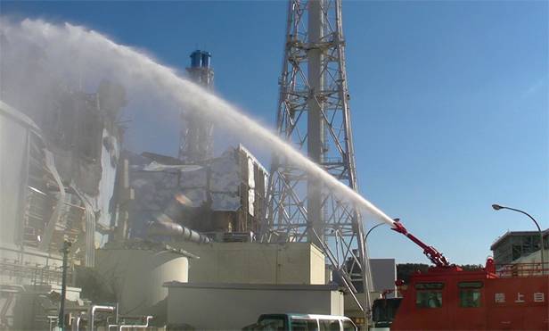
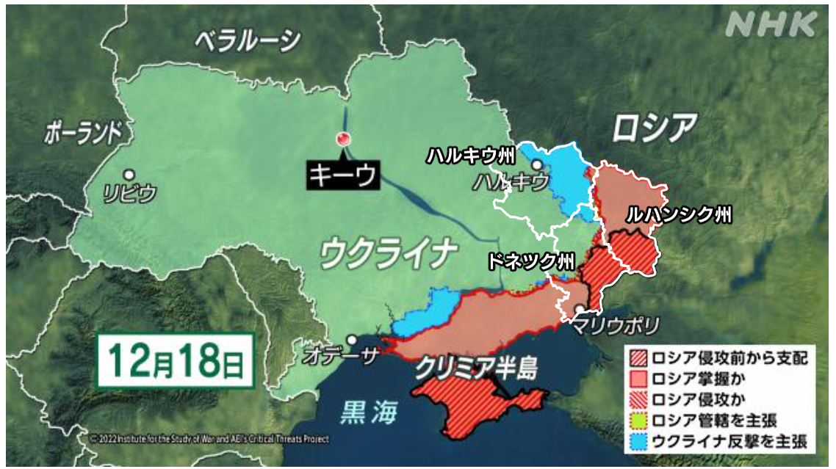
1
Background
East Asian countries such as Japan, China, and South Korea are manufacturing powerhouses and have massive energy demands. As a result, countries are focusing their research on ensuring energy security, reducing their dependence on conventional energy, and promoting carbon neutrality.
In recent years, Japan's energy security has been continuously challenged. The power crisis caused by the Great East Japan Earthquake and the soaring oil and gas prices triggered by the war in Russia and Ukraine have forced Japan to improve its energy self-sufficiency.

Slide 4
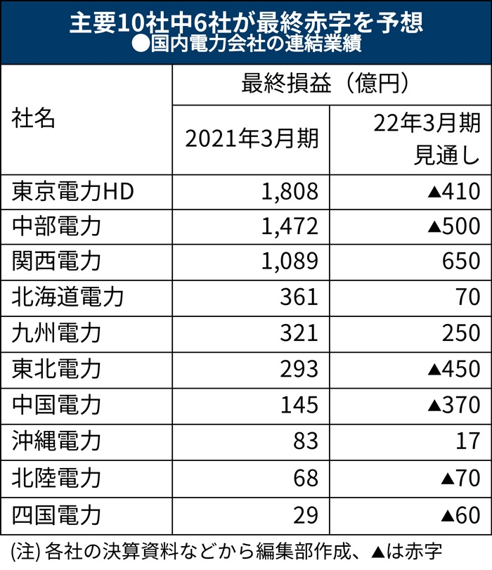
1
Background
Electricity prices in Japan are rising on average by about 30% from 2021 to 2022.
At the end of January, when the financial results of Japan's 10 major electric power companies for the April-December period of 2021 were released, six of them were already forecasting a net loss for the full year ending March 31, 2022. The subsequent invasion of Ukraine by Russia appears to have further inflated the procurement costs of these companies.
参考：日本の電気料金3兆～5兆円増も ウクライナ危機でエネルギー高騰
Notes:
日本国内の電気料金は2021年から2022年にかけ、平均(へいきん)して約3割も高騰(こうとう)している。

Slide 5
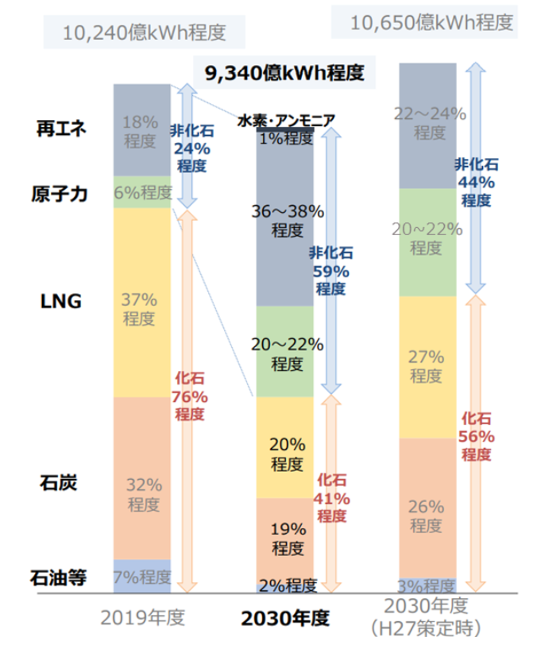
1
Background
In order to achieve "carbon neutrality by 2050," the Japanese government announced the Sixth Basic Energy Plan in October 2021.
The share of renewable energy was 22-24% in the previous plan, but has been raised to 36-38% in the current review. Nuclear power will continue to be maintained at 20-22%.
参考：経済産業省 資源エネルギー庁「2050年カーボンニュートラルを目指す 日本の新たな「エネルギー基本計画」」
Notes:
エネルギー価格を下げるために、日本政府は再生可能エネルギーを促進(そくしん)するためのさまざまな政策を提案(ていあん)しています。

Slide 6
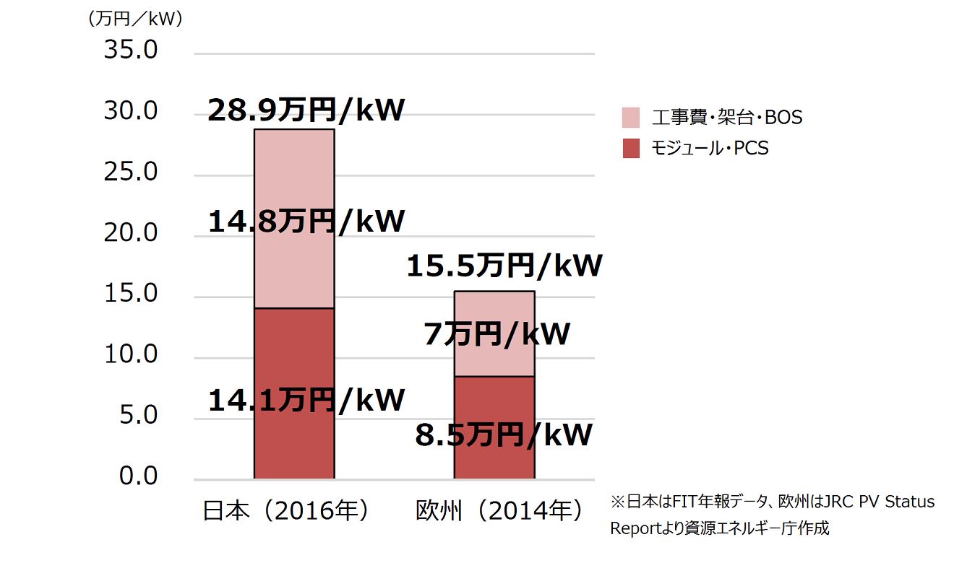
1
Background
Compared to Europe and the U.S., where the price level remains the same, internationally traded solar panels and wind turbines are about 1.5 times more expensive in Japan, and the construction cost of installing them is also about 1.5 to 2 times higher, according to a survey.
参考：経済産業省・資源エネルギー庁 「再エネのコストを考える」
日欧の太陽光発電（非住宅）システム費用比較

Slide 7


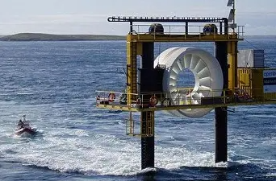
1
Background
The purpose of this study is to reduce the cost of renewable energy and increase energy production using the latest artificial intelligence optimization techniques.
Notes:
最新の人工知能最適化技術を使用して、再生可能エネルギーのコストを削減(さくげん)し、エネルギー収量（しゅうりょう）を増やする

Slide 8
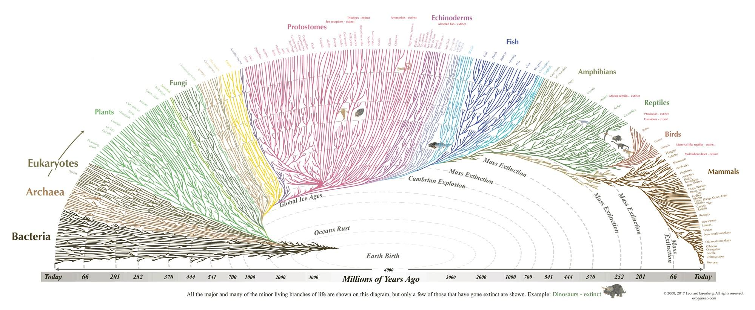
1
Background – Meta-heuristic algorithms
Meta-heuristic algorithms, as important optimization algorithms in the field of artificial intelligence, have great potential in the field of renewable energy.

Slide 9
1
Background – Meta-heuristic algorithms
Addressing optimization problems is crucial in the study of a wide range of scientific and engineering issues [1].
Heuristic algorithm [2]: One way of quickly arriving at a viable solution. It provides feasible solutions in a reasonable amount of time and space, but does not guarantee the best solution.
Meta-heuristic algorithm (MHAs) [3]: It is a generalized heuristic method that can be applied to a broader range of situations than the specific conditions of a particular problem.
Optimization Methods
Heuristic
Meta-heuristic
Chumburidze, M., Basheleishvili, I., & Khetsuriani, A. (2019). Dynamic programming and greedy algorithm strategy for solving several classes of graph optimization problems. BRAIN. Broad Research in Artificial Intelligence and Neuroscience, 10(1), 101-107.
Pearl, J. (1984). Heuristics: intelligent search strategies for computer problem solving.
Hussain, K., Salleh, M. N. M., Cheng, S., & Shi, Y. (2019). Metaheuristic research: a comprehensive survey. Artificial Intelligence Review, 52(4), 2191-2233.

Slide 10
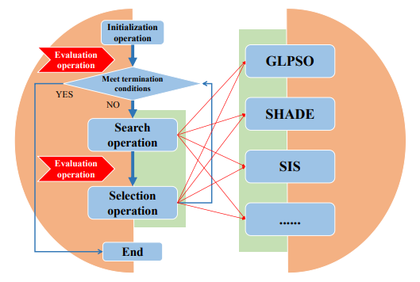
1
Background – Meta-heuristic algorithms
A meta-heuristic algorithm typically contains an initialization operation, a search operation, an evaluation operation, and a selection operation.

Slide 11


1
Background – Several interesting applications of MHAs
Anastasia Opara opened a project on GitHub: genetic drawing [4]. Its main purpose is to complete the painting work with the help of a genetic algorithm.
4.GitHub：anopara/genetic-drawing

Slide 12
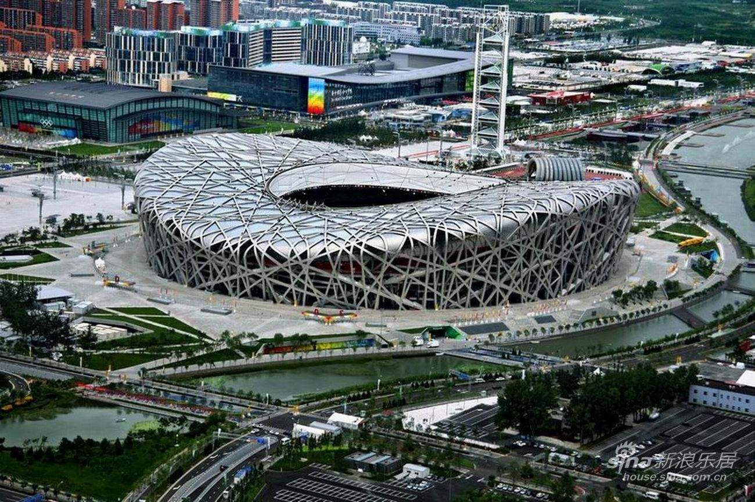
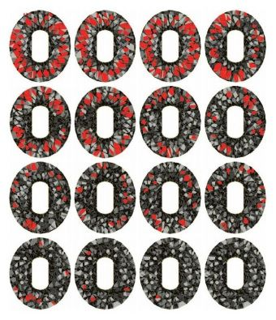
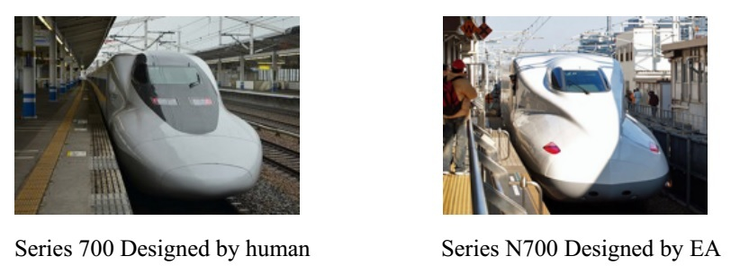
1
Background – Several interesting applications of MHAs
The steel structure of the Beijing Bird's Nest gymnasium is iterated by a genetic algorithm, which is very stable. [5]
The unique aerodynamic nose of Shinkansen N700 series models in Japan is the result calculated by genetic algorithm. [5]
5. https://www.zhihu.com/question/26934313/answer/36716706

Slide 13
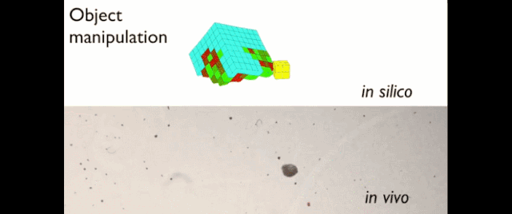
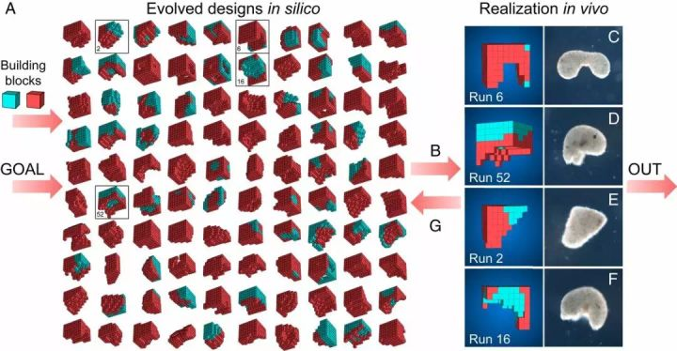
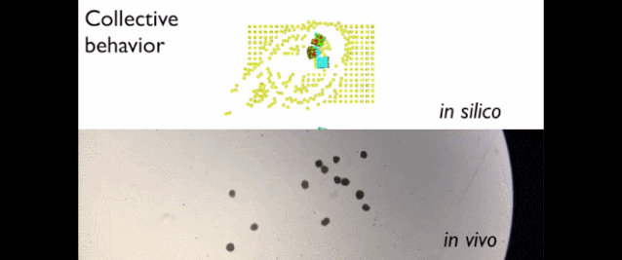
1
Background – Several interesting applications of MHAs
Recently, researchers at the University of Vermont have developed a biological robot called Xenobot using an evolutionary algorithm. It is composed of biological cells that can be programmed, modified, and moved freely. Even if it is cut, it can heal automatically. [6]
6. Kriegman, S., Blackiston, D., Levin, M., & Bongard, J. (2020). A scalable pipeline for designing reconfigurable organisms. Proceedings of the National Academy of Sciences, 117(4), 1853-1859.

Slide 14
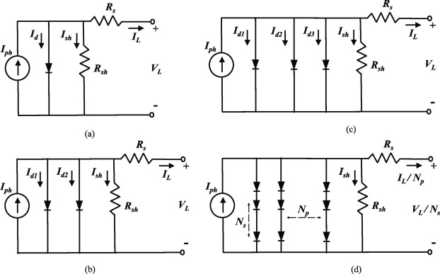
1
Background – Several applications of MHAs in the field of renewable energy
Photovoltaic (PV) generation systems are vital to the utilization of the sustainable and pollution-free solar energy.
In [7], researchers propose a state-of-the-art optimization method, namely, directional permutation differential evolution algorithm (DPDE), to tackle the parameter estimation of several kinds of solar PV models.
Equivalent circuit of PV: (a) single diode model, (b) double diode model, (c) triple diode model, and (d) PV module model.
7. Gao, S., Wang, K., Tao, S., Jin, T., Dai, H., & Cheng, J. (2021). A state-of-the-art differential evolution algorithm for parameter estimation of solar photovoltaic models. Energy Conversion and Management, 230, 113784. (Highly Cited Paper, Top 1%)

Slide 15
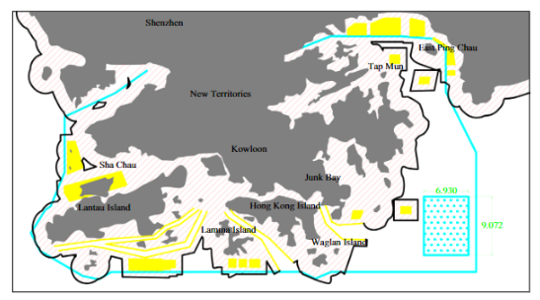
1
Background – Several applications of MHAs in the field of renewable energy
A case study of wind turbine layout optimization using the multi-population genetic algorithm [8] in a hypothetical offshore wind farm located in Hong Kong's southeast waters is attempted using 20 years of wind data from 1992 to 2011. The optimization result is beneficial for the assessment of the offshore wind power potential in Hong Kong.
Hong Kong territory map and location of the hypothetical offshore wind far
8. Gao, X., Yang, H., Lin, L., & Koo, P. (2015). Wind turbine layout optimization using multi-population genetic algorithm and a case study in Hong Kong offshore. Journal of Wind Engineering and Industrial Aerodynamics, 139, 89-99.

Slide 16

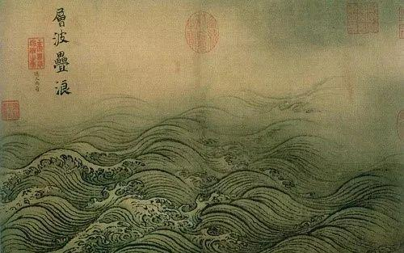
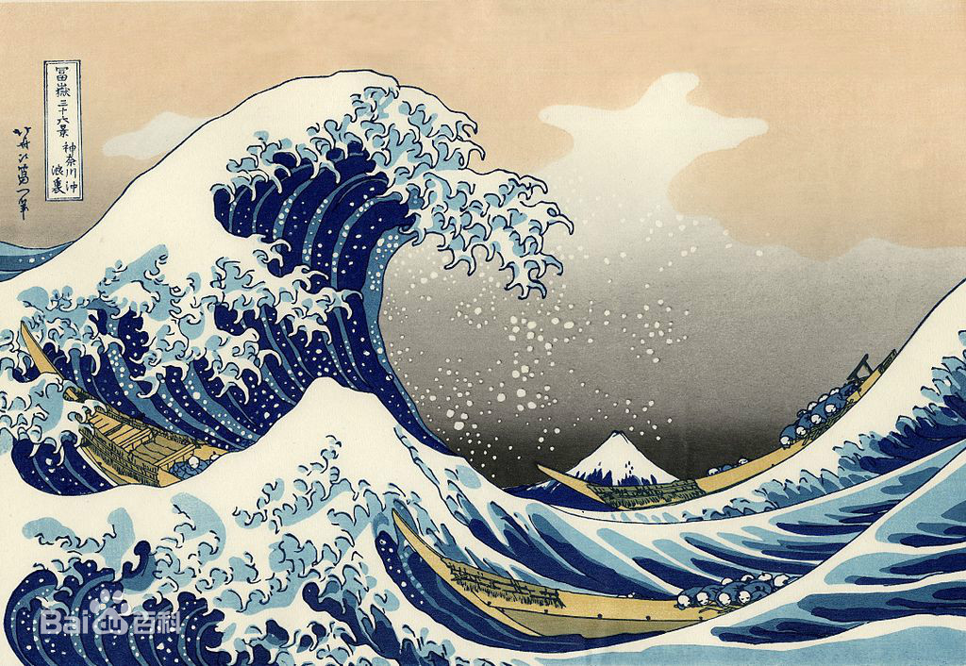
1
Background – Turbulence in the field of renewable energy
In the field of renewable energy optimization, especially wind and wave energy engineering optimization studies, turbulence poses great difficulties.
In fact, turbulence has been known for a long time. From Leonardo da Vinci's manuscripts to Van Gogh's "Starry Night", from《水图卷》 to 「神奈川沖浪裏」, painters have used their artistic brush to coincidentally depict visual images of turbulence.

Slide 17
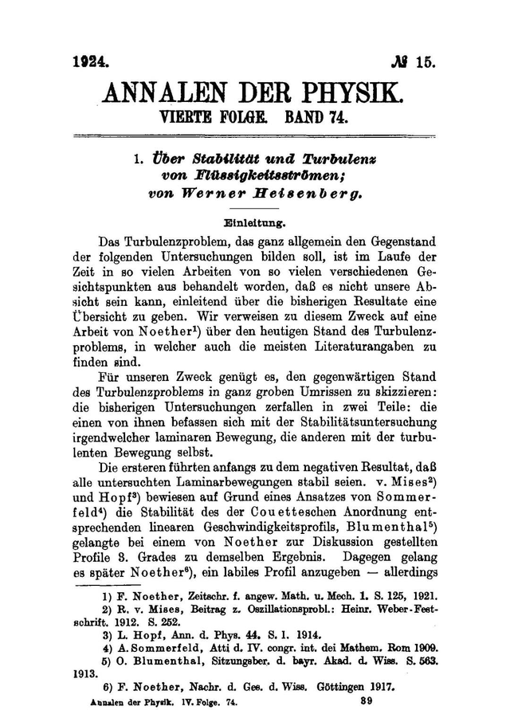
1
Background – Turbulence in the field of renewable energy
Turbulence is an extremely complex phenomenon of physics. On 1924, Heisenberg published a calculation entitled "Über Stabilität und Turbulenz von Flüssigkeitsströmen" [9] in the Annals of Physics.
This problem is a classical problem of turbulence—determining the exact transition from laminar to turbulent flow—and one so difficult that Heisenberg provided only an approximate solution.
[9] Werner Heisenberg. Über Stabilität und Turbulenz von Flüssigkeitsströmen.Annalen der Physik, 379(15):577–627, 1924.

Slide 18
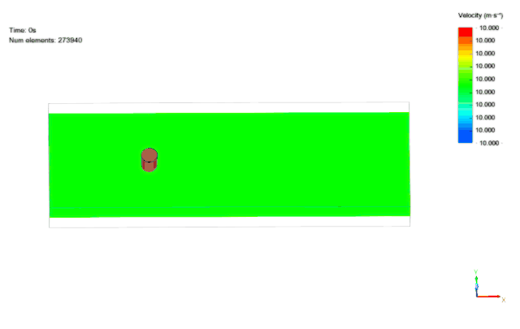
1
Background – Reasons for adopting MHAs
Traditional methods for solving problems related to wind farm layout optimization and position optimization of wave energy converters consume a large amount of human and computational resources due to the complexity of turbulence.
Therefore, since the MHAs are able to provide a feasible solution to the problem at an acceptable cost (in terms of computational time and space), they become an important tool for solving the above problems. [10]
10. Liu, Z., Peng, J., Hua, X., & Zhu, Z. (2021). Wind farm optimization considering non-uniformly distributed turbulence intensity. Sustainable Energy Technologies and Assessments, 43, 100970.

Slide 19
1
Background – Research contributions
Contribution 1: To design superior algorithms to handle the position optimization problems of wave energy converters (WECP) and wind farm layout optimization problems (WFLOP) in order to obtain higher energy output.
Contribution 2: To try to identify a design guidance scheme for MHAs based on complex systems theory in order to reduce the time and labor cost required for algorithm design.
In this study, we successively designed the spatial information sampling algorithm (SIS) and the improved spherical evolution (ISE).

Slide 20
CONTENTS
1. Background
2. Spatial information sampling algorithm
3. Improved spherical evolution
4. Conclusion

Slide 21
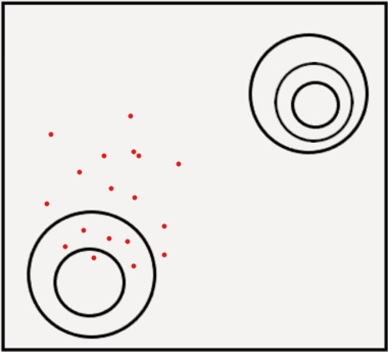
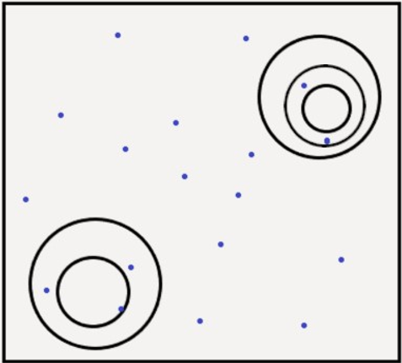
2
Spatial information sampling algorithm- Theoretical basis
Because of MHAs' superior performance in addressing optimization problems, how to design a MHA with superior performance has become the focus of research in MHAs' community. In recent decades, researchers appear to have concluded that maintaining a balance between exploitation and exploration is critical for improving MHAs' performance. [11]
Exploitation: The idea of focusing the search process on promising areas of the solution space. (Easy to fall into local optimal)
Exploration: The ability of a search algorithm to discover a diverse array of solutions spread across different regions of the search space. (The convergence ability becomes weak)
Global optimal
Global optimal
Exploitation
Exploration
local optimum
local optimum
11. Črepinšek, M., Liu, S. H., & Mernik, M. (2013). Exploration and exploitation in evolutionary algorithms: A survey. ACM computing surveys (CSUR), 45(3), 1-33.
Notes:
First I will introduce the theoretical basis of the SIS algorithm.

Slide 22
2
Spatial information sampling algorithm- Theoretical basis
Start
There are three main ways to realize exploitation and exploration
operations: selection, attraction, and perturbation operations.
Population initialization
yes
End of iteration?
end
no
Three operations
Four schemes
MHAs
Search
Perturbation
Deterministic
GWO, HGSA, SCA, …
Evaluation
Adaptive
CGSA-M, MDBSO, …
Attraction
screen
Selection
Hybrid
DE, CJADE, GLPSO …
Selection
New population
Intelligent
SIS
The main steps of MHAs
The main classes of MHAs

Slide 23
2
Spatial information sampling algorithm- Theoretical basis
In essence, the balance of exploitation and exploration of MHAs is realized by combining selection, attraction, or perturbation operations. We divide the main combination methods into the following three types: deterministic, adaptive, and hybrid schemes.
Three operations
Four schemes
MHAs
However, these schemes are both prior experience-based schemes that restrict the acquisition and application of information by the algorithm itself, causing the algorithm to stray from the path of “intelligence".
Perturbation
Deterministic
GWO, HGSA, SCA, …
Adaptive
CGSA-M, MDBSO, …
Attraction
screen
Hybrid
DE, CJADE, GLPSO …
Selection
Intelligent
SIS

Slide 24
2
Spatial information sampling algorithm- Theoretical basis
To address the aforementioned problems, this study proposes an intelligent scheme that aims to give the algorithm more decision-making authority to determine when to perform exploration or exploitation.
Three operations
Four schemes
MHAs
Thus, a spatial information sampling (SIS) algorithm that uses an intelligent scheme is proposed.
Perturbation
Deterministic
GWO, HGSA, SCA, …
Adaptive
CGSA-M, MDBSO, …
Attraction
screen
Hybrid
DE, CJADE, GLPSO …
Selection
Intelligent
SIS

Slide 25
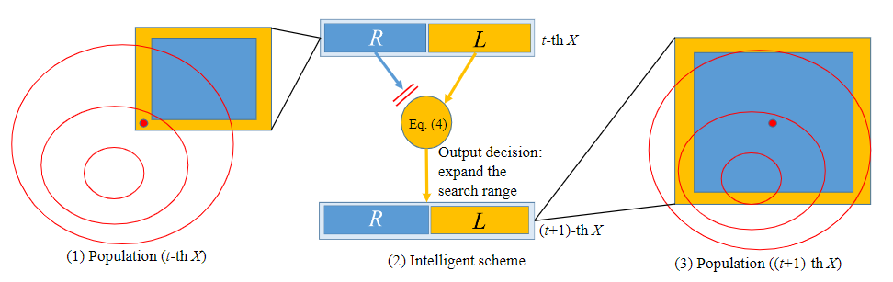
2
Spatial information sampling algorithm- Basic idea of SIS
In this study, we regard the problem to be optimized as a space in which the SIS population swims to find the global best. The entire SIS population is referred to as X, and it is divided into two sub-populations, L and R, with individuals in L distributed along the population's periphery and R distributed evenly.
Fig. 1
Notes:
When the current optimal individual is observed in $L$, it indicates that the search space covered by the population is not large enough, and the better individual may still be outside the current range. Then the perturbation operation of the intelligent scheme is activated: when the next generation of $X$ is generated, the current optimal individual is regarded as the center, and the distance between individuals is expanded. As a result, SIS's exploration ability is enhanced. The mechanism of perturbation operation is shown in Fig. \ref{perception1}, where the contour line is represented by the circle in the figure, and the smaller the circle, the better the fitness value. The square is the range of $X$, the yellow part is $L$ and the blue part is $R$. The red dot represents the current optimal individual.

Slide 26
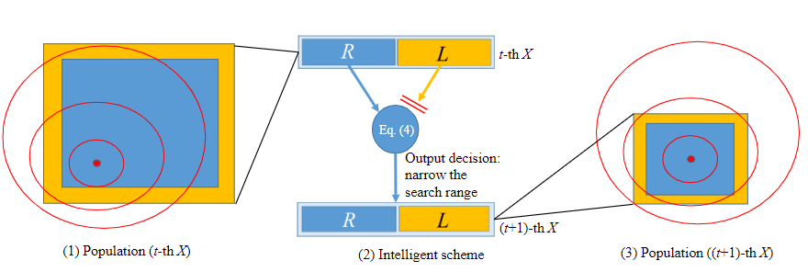
2
Spatial information sampling algorithm- Basic idea of SIS
In this study, we regard the problem to be optimized as a space in which the SIS population swims to find the global best. The entire SIS population is referred to as X, and it is divided into two sub-populations, L and R, with individuals in L distributed along the population's periphery and R distributed evenly.
Fig. 2
Notes:
When the current optimal individual is observed in $R$, it indicates that the population may have covered a promising search area. Then the attraction operation of the intelligent scheme is activated: when the next generation of $X$ is generated, the current optimal individual is regarded as the center, and the distance between individuals is reduced. As a result, SIS's exploitation ability is enhanced. The mechanism of attraction operation is shown in Fig. \ref{perception2}.

Slide 27
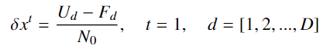
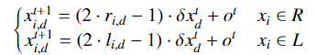
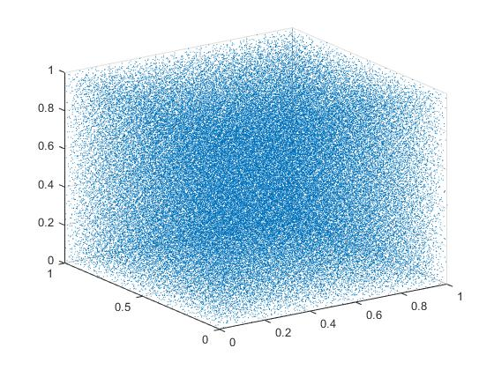
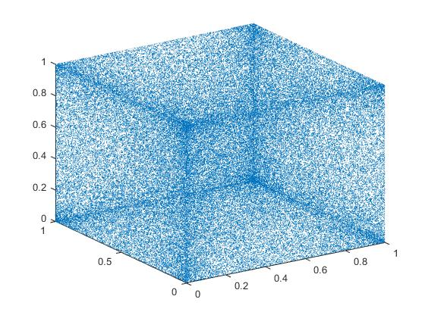
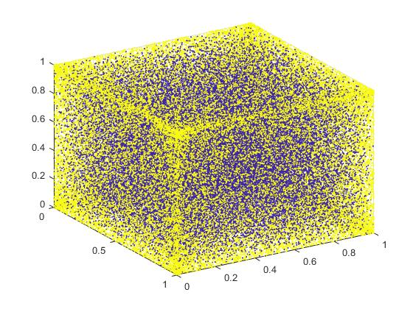
2
Spatial information sampling algorithm - Basic components of SIS
The generation process of individuals xi in R and L is written as:
denotes a discrete step, representing the distance between each individual in each dimension.
(1)
The sub-population generated by the random sequence is called R. The other one generated by the Logistic map (a kind of chaotic map) is referred to as L.
where Ud and Fd are the upper and lower limits of the solution space in the d-dimension, respectively.
where ri,d is generated by the random sequence and li,d is generated by the Logistic map
(2)
(3)
+
=
Distribution graph of R.
Distribution graph of L.
Distribution graph of X.

Slide 28
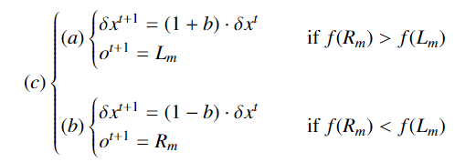
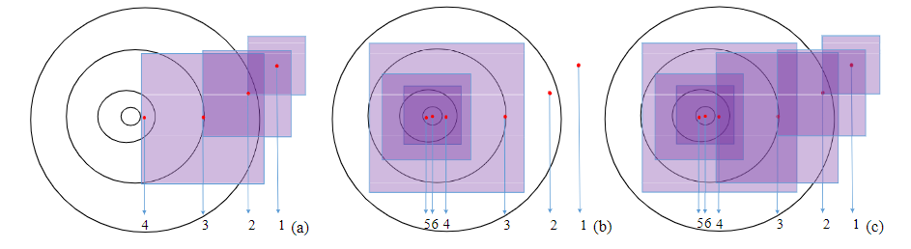
2
Spatial information sampling algorithm - The realization of intelligent scheme
Without loss of generality, the optimization of a minimization problem is considered.
After generating X, the fitness values of all individuals are calculated, and thereafter those with the best value in R and L are denoted by Rm and Lm, respectively. When f(Lm)< f(Rm), is increased. When f(Lm)>f(Rm), is reduced.
(4)
where b is the parameter for adjusting the distance between individuals. The optimal individual is represented as o.
Fig. 3 Two-dimensional schematic diagram of SIS in the iterative process.
Notes:
Figs. $(a)$, $(b)$ and $(c)$ in Fig. \ref{mechanism} are consistent with the operations represented by Eqs. $(a)$, $(b)$ and $(c)$ in Eq. (\ref{(2.5)}).

Slide 29
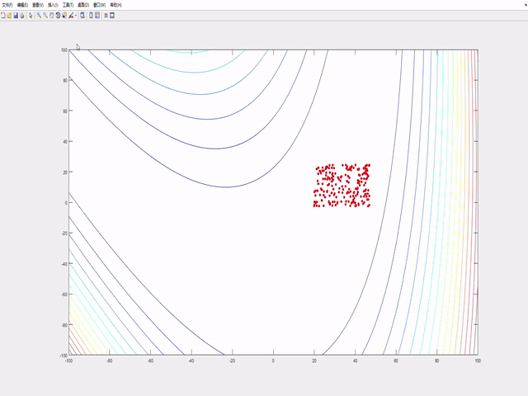
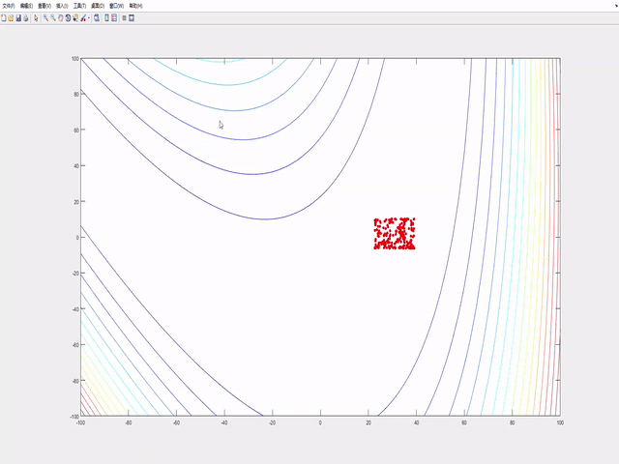
2
Spatial information sampling algorithm- Iterative process of SIS
Fig. 3 Two-dimensional schematic diagram of SIS in the iterative process.
Notes:
The contour line is the same as Fig. 1. The square is the range of the population $X$, and the red dot represents the current optimal individual. The numbers in the figure represent the number of iterations $t$. The perturbation operation is represented in Fig. (a). When the global optimal area is not found, the population will move towards a better fitness value. Simultaneously, the search range of the population is continuously expanded. The attraction operation is represented in Fig. (b). When the search range of the population encompasses the global optimal area, the search range begins to converge. The whole optimization process of SIS is represented in Fig. (c).

Slide 30
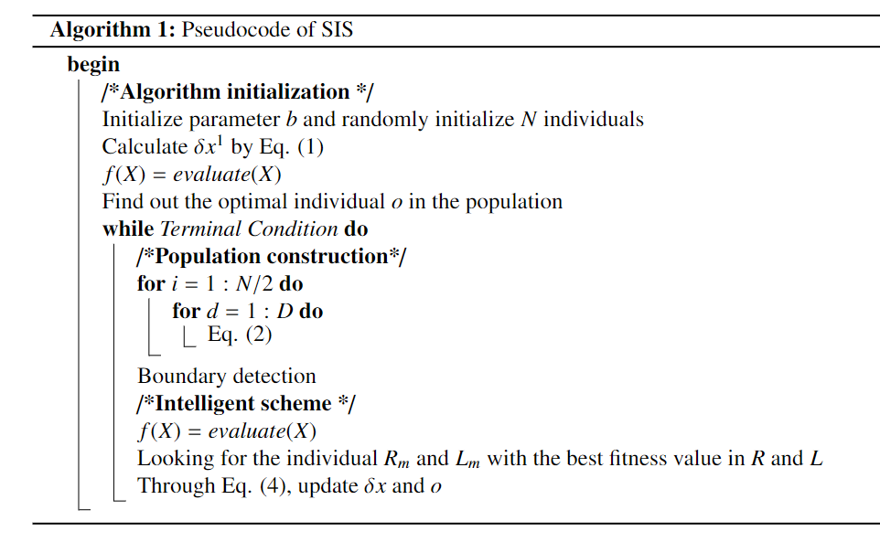
2
Spatial information sampling algorithm- The main steps of SIS

Slide 31
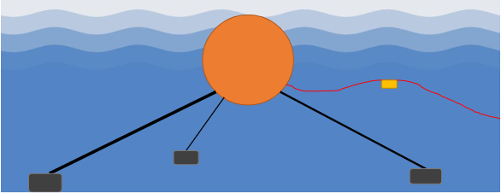
2
Spatial information sampling algorithm - Experimental Results
Because of the high energy density of waves, wave energy is one of the most promising forms of renewable energy currently available. [12] In this section, we attempt to use SIS to optimize the placement of wave energy converters [13], and we compare SIS with an improved differential evolution algorithm (IDE) [14] modified specifically for this problem under four real wave regimes (Perth, Adelaide, Tasmania, and Sydeny).
12. Drew, B., Plummer, A. R., & Sahinkaya, M. N. (2009). A review of wave energy converter technology. Proceedings of the Institution of Mechanical Engineers, Part A: Journal of Power and Energy, 223(8), 887-902.
13. Sergiienko, N. Y., Cazzolato, B. S., Ding, B., & Arjomandi, M. (2016, October). Three-tether axisymmetric wave energy converter: estimation of energy delivery. In Proc. 3rd Asian Wave and Tidal Energy Conference (AWTEC), Singapore (pp. 23-25).
14. Fang, H. W., Feng, Y. Z., & Li, G. P. (2018). Optimization of wave energy converter arrays by an improved differential evolution algorithm. Energies, 11(12), 3522.

Slide 32
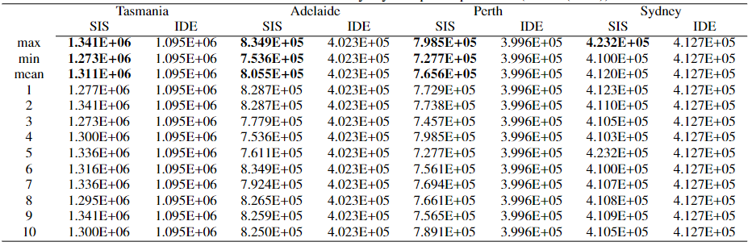
2
Spatial information sampling algorithm - Experimental results
In the Table, the output with the best performance is highlighted in bold. It can be found that the maximum value of SIS in the four wave scenarios is significantly higher than that of IDE.

Slide 33
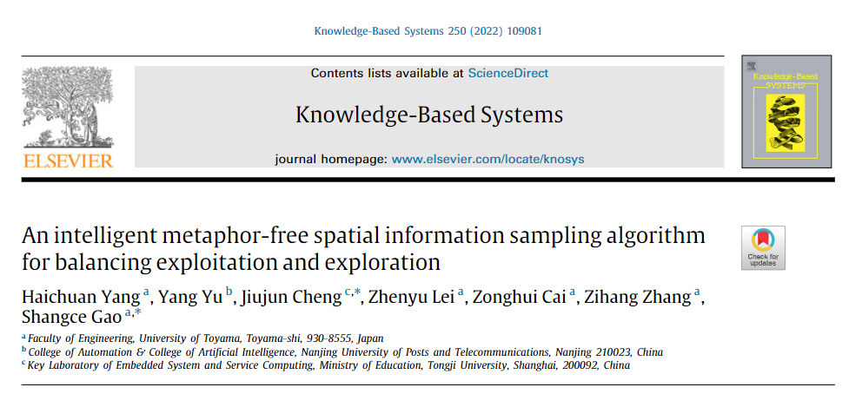
2
Spatial information sampling algorithm
The results of this study are presented in Knowledge-Based Systems.

Slide 34
2
Spatial information sampling algorithm - Summary
Although we proposed SIS and obtained higher energy output for the position optimization problems of wave energy converters, SIS did not perform well in solving the wind farm layout optimization problem.
This shows that relying on exploitation and exploration theory to design the algorithm is not comprehensive, so we introduced complex networks to design the new MHA.

Slide 35
CONTENTS
1. Background
2. Spatial information sampling algorithm
3. Improved spherical evolution
4. Conclusion

Slide 36
3
Improved spherical evolution - Complex networks
The study of large and complex interactions that exist in the real world is known as complex networks. It is also a field of complex systems in that the properties of the entire system are determined by the interaction of numerous factors.
On the one hand, artificial intelligence can study real complex systems problems. On the other hand, complex systems theory can be used to study artificial intelligence.
複雑系
人工知能

Slide 37
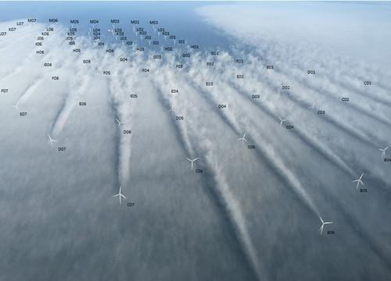
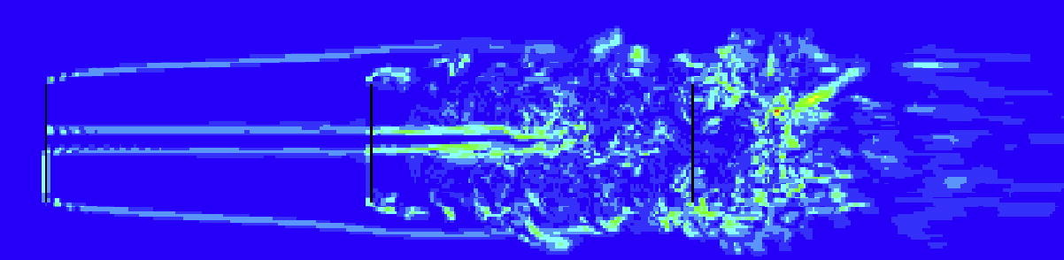
3
Improved spherical evolution - Wake effects
The optimization problem of wind power generation is one of the NP-complete problems. Since most conventional wind farm layouts follow a certain geometry in a regular manner, the wake effects are also very severe in large wind farms, as shown in the figure.
During the design phase of a wind farm, determining how to construct a rational wind turbine layout that minimizes wake effects is one of the key techniques for increasing the overall power generation capacity of the wind farm.

Slide 38
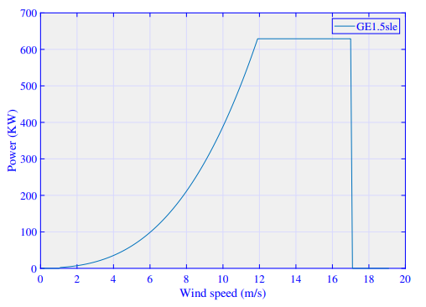
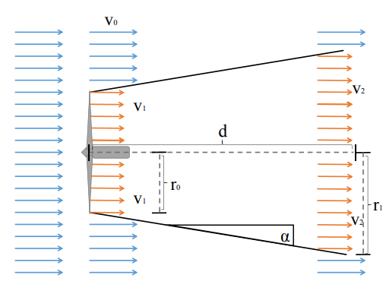
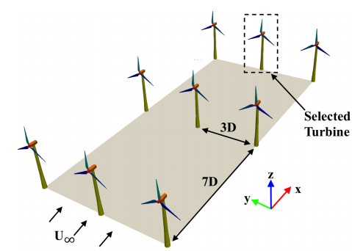
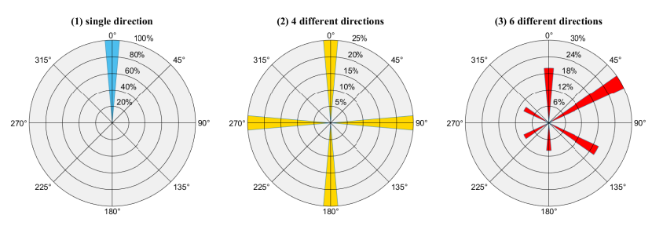
3
Improved spherical evolution - Construction of wind farm model
（1）Turbine output model
（2）wake effects model
+
=
（4）Wind Farm Model
（3）Wind speed and direction model

Slide 39
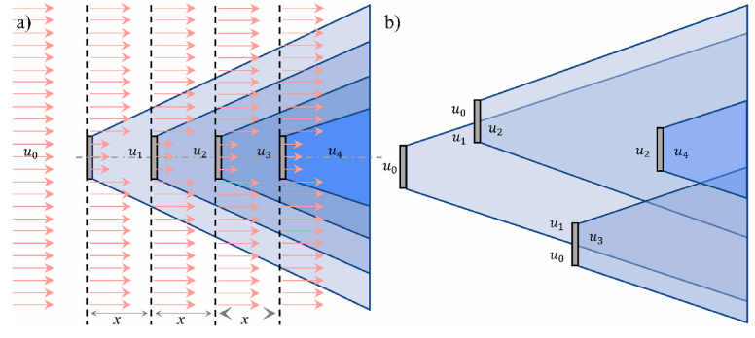
3
Improved spherical evolution - Objective function
Top view of wind farm
Objective function = Minimize wake effects (maximize wind energy conversion)
In other words, from the bad situation in Figure a to the ideal situation in Figure b.

Slide 40

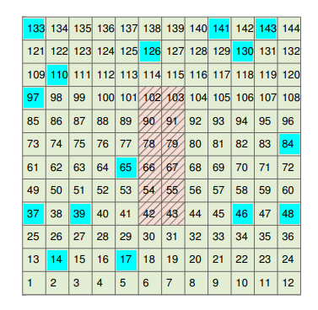
3
Improved spherical evolution - Challenges in optimizing the layout of wind farms
Top view of wind farm
Top view of large scale wind farm
In a layout solution, each square is a location where a wind turbine can be installed. Blue squares are actual wind turbine locations.
As the size of the wind farm increases, the options for wind turbine placement increase dramatically, making it difficult to choose the option with the lowest wake effects (as shown in the figure on the right).
layout solution
layout solution

Slide 41
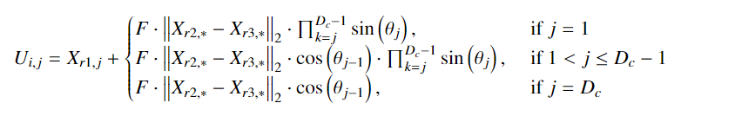
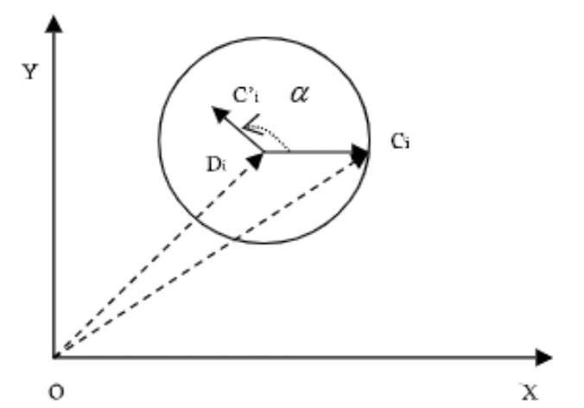
3
Improved spherical evolution - Basic idea of ISE
The search operation of ISE can be represented as:
We mainly increased the value of the scaling factor F, thus further increasing the search range of SE to try to search for more peaks.
Notes:
where Ui is a temporary offspring individual. r1, r2, r3 represents the index of the individual. F denotes a scale factor that can appropriately adjust the search radius length. In SE, the worse the individual's solution, the greater the value of F. |Xr2, *-Xr3, *|2 denotes the radius of the sphere computed by the Euclidean norm in high dimensions. Dc is the dimension of the original D after the dimensionality reduction operation. * is the set of all dimensions after dimensionality reduction. Θ is generated by a random number of uniform distribution between [0,2π].

Slide 42
3
Improved spherical evolution - Optimization steps
Start
Population initialization
yes
Meet the termination conditions
no
layout solution 1
layout solution 2
layout solution 3
Search operation of ISE
Evaluation
Selection
Step 1.First, several parent layout solutions
are generated as a population, and the wake effects are calculated for each solution.
New population
End
Main steps of ISE

Slide 43
3
Improved spherical evolution - Optimization steps
Start
Population initialization
The offspring layout solutions generated by the parent layout solutions.
yes
Meet the termination conditions
no
Search operation of ISE
Evaluation
Selection
... ... ...
... ... ...
... ... ...
New population
Step 2.Then, a search operation is performed on each layout solutions using ISE to generate new populations.
End
Main steps of ISE

Slide 44
3
Improved spherical evolution - Optimization steps
Start
Population initialization
yes
Meet the termination conditions
no
Search operation of ISE
Evaluation
Selection
... ... ...
... ... ...
... ... ...
New population
Step 3.The energy conversion rate of each individual (layout solution) in the new population under the influence of the wake effects is calculated by the evaluation operation. The conversion rates of individuals in the new population are then compared with those in the parent population, and the individuals with higher conversion rates are finally selected.
End
Main steps of ISE

Slide 45
3
Improved spherical evolution - Optimization steps
Start
Population initialization
yes
Meet the termination conditions
no
After several iterations, the most ideal layout solution is selected.
Search operation of ISE
Evaluation
Selection
... ... ...
... ... ...
... ... ...
New population
Optimal layout for power generation
End
Main steps of ISE

Slide 46
3
Improved spherical evolution - Theoretical basis
In the course of our research, we discovered a link between the algorithm and the problem being optimized.
There are two general types of problems that are optimized: multi-peak problems and single-peak problems.
multi-peak problems
single-peak problems

Slide 47
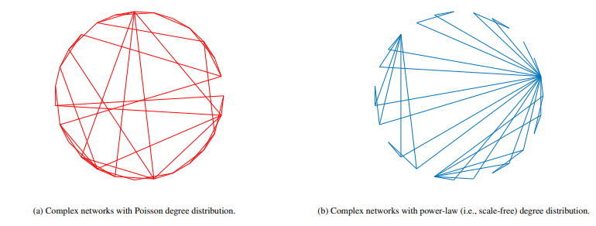
3
Improved spherical evolution - Theoretical basis
Interestingly, MHAs fall into two categories depending on the complexity of the network.
We count the links between individuals during the iterations of the algorithm and fit the obtained data.
Eventually, it is determined that some MHAs are small-world networks with Poisson distributions, while others are scale-free networks.
複雑系
人工知能

Slide 48
3
Improved spherical evolution - Theoretical basis
MHAs with small-world network properties are suitable for optimizing multi-peak problems, while algorithms with scale-free network properties are suitable for optimizing single-peak problem.
Based on this finding, researchers can quickly select the corresponding metaheuristic algorithms for problems with different characteristics, thus greatly reducing the trial-and-error cost.

Slide 49
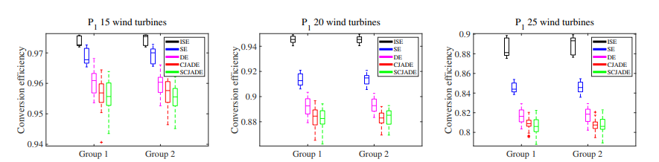
3
Improved spherical evolution - Theoretical basis
Experimental results show that SE [15] and DE [16] algorithms with small-world network properties are superior to CJADE [17] and SCJADE [18] with scale-free network properties on WFLOP.
We speculate that WFLOP is more oriented to multi-peak problems and therefore propose the improved SE.
15.Tang, D. (2019). Spherical evolution for solving continuous optimization problems. Applied Soft Computing, 81, 105499.
16.Das, S., & Suganthan, P. N. (2010). Differential evolution: A survey of the state-of-the-art. IEEE transactions on evolutionary computation, 15(1), 4-31.
17.Gao, S., Yu, Y., Wang, Y., Wang, J., Cheng, J., & Zhou, M. (2019). Chaotic local search-based differential evolution algorithms for optimization. IEEE Transactions on Systems, Man, and Cybernetics: Systems, 51(6), 3954-3967.
18.Xu, Z., Gao, S., Yang, H., & Lei, Z. (2021). SCJADE: Yet Another State‐of‐the‐Art Differential Evolution Algorithm. IEEJ Transactions on Electrical and Electronic Engineering, 16(4), 644-646.

Slide 50
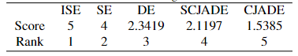

3
Improved spherical evolution - Experimental Results
Experimental results show that the ISE is superior to SE, DE, CJADE and SCJADE on WFLOP.
Friedman test of five algorithms on WFLOP.
Conversion efficiency on wind distribution P1

Slide 51

3
Improved spherical evolution - Experimental results
ISE is also found to be significantly better than the SUGGA and LSHADE (Top algorithms in the field of MHAs) .

Slide 52
CONTENTS
1. Background
2. Spatial information sampling algorithm
3. Improved spherical evolution
4. Conclusion

Slide 53
4
Conclusion
Purpose
In this study, we design a SIS algorithm and an ISE algorithm to address WEC and WFLOP, respectively.
Method
The design of SIS and ISE is based on exploitation and exploration theory and complex network theory.
Significance
The development of the above two algorithms not only effectively improves the conversion efficiency of renewable energy, but also lays the foundation for further application of MHAs in the field of energy optimization.

Slide 54
THANK YOU
Notes:
That's all of my presentation. Thank you very much for your time and attention.

